Slide 1
Microprocessor tools and kits suitable for education
IEEE Life Members mtg July 20, 2017
James C. Brakefield

Slide 2
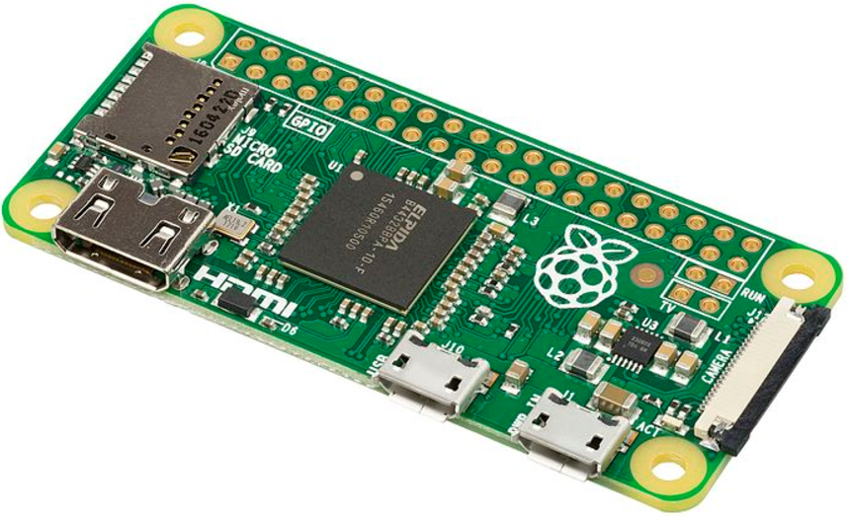
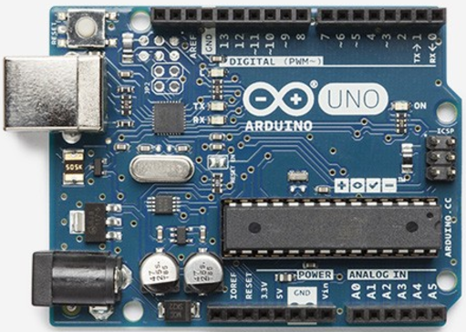
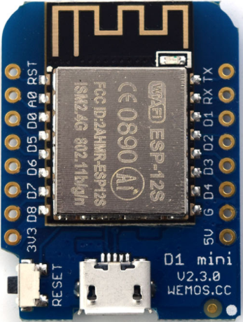
Microprocessor boards

Slide 3
Some Nostalgia
8080 1974 Intel 8-bit data, 16-bit address followed by 8085 and 8051
6502 1975 MOS Technology 8-bit data, 16-bit address Apple, Commodore, Atari
Z80 1976 Zilog 8-bit data, 16-bit address Osborne 1, KayPro, TRS-80
8086 1978 Intel 8 & 16-bit data, 20-bit address PC

Slide 4
Current microprocessors
PIC 1975 Microchip 8-bit data, 8-bit address 10B+ mfg’d, separate data & instruction mem
AVR 1996 Atmel 8-bit data, 16-bit address 1B+ mfg’d, basis for Arduino boards
MSP430 1993 TI 8/16-bit data, 16-bit address 1B+ mfg’d, low power, LaunchPad boards
ARM 1985 ARM Holdings 8/16/32-bit data, 32-bit adr 100B+ mfg’d, ARM licenses to mfgs, basis for Raspberry Pi boards
STM8 STMicro 8-bit data, 24-bit adr, 2B+ mfg’d

Slide 5
Other notable uP choices
ESP8266, ESP32: Espressif 32-bit RISC
WiFi & BlueTooth radio built in, low cost
PSoC: Cypress
ARM chip with some programmable logic
ZPUino: Oyvind Harboe & Alvaro Lopes
32-bit soft-core (FPGA) processor, runs Linux
X86: Intel Curie module
projected to do well next year

Slide 6
Pinouts & Form factors
Boards provide processor signal breakout areas
Bused to other boards and are allocated by user
Arduino: Two rows of 0.1” spaced pins 2” apart (board is 2.1” wide)
Raspberry Pi: Two rows of 20 pins with 0.1” by 0.1” spacing along one PCB edge
DIL breadboard: PCB is about 1” wide with 0.1” spaced pins on each side
Miscellaneous: Dual DIL, circular (for clothing), snap or click together…

Slide 7
Accessory boards
Pmod 6 & 12 pin, supports I2C, SPI, analog, digital
Grove 4 pin, supports I2C, analog, digital
Hats & shields Stackable boards plugging into Arduino or Raspberry Pi, also Wemos & Tinycircuits
Breakout boards Provides 0.1” spaced holes connected to chip pins (often miniscule)

Slide 8
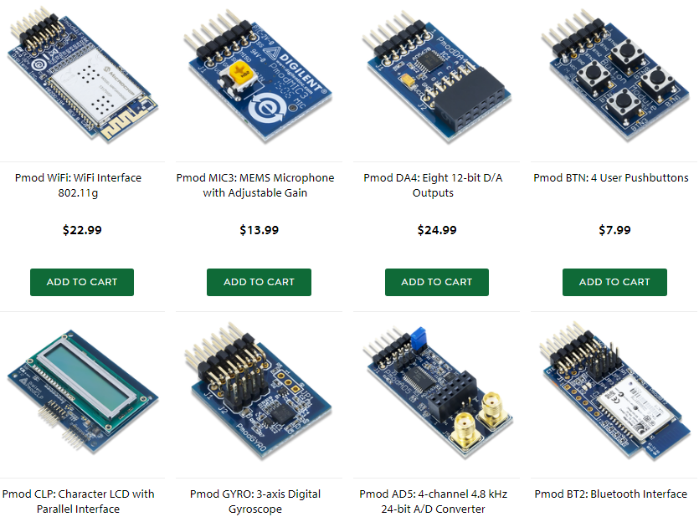
Pmod (www.digilentinc.com)

Slide 9
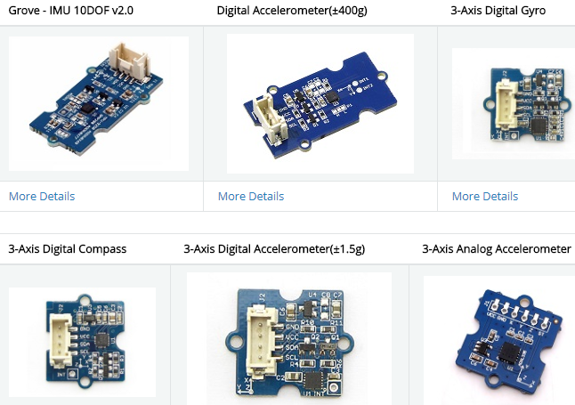
Grove (wkik.seeed.cc/Grove_System)

Slide 10
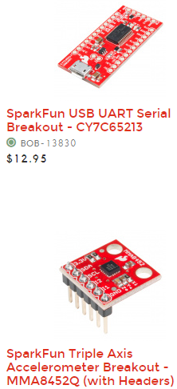
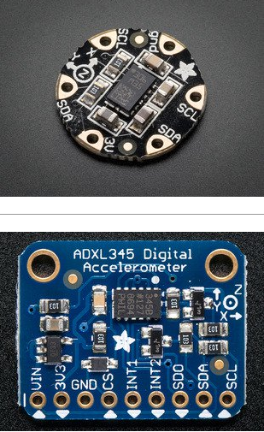
Breakout boards (adafruit & sparkfun)

Slide 11
Kits
Had this idea two years ago to do $20 (parts cost) microprocessor kits for middle school and high school kids.
Arduino kits now available starting at $10-$25
One can do Arduino using the bare processor chip and a USB to TTL serial port converter on a breadboard (but clones are under $4)

Slide 12
Vendors (partial list)
Amazon: boards, kits, hobby electronics, books
Adafruit: boards, kits, hobby electronics
Sparkfun: boards, kits, hobby electronics
Pololu: boards, kits, hobby electronics, motors
Element14: parts, boards, kits
Digikey: parts, boards
Mouser: parts, boards
Banggood, AliExpress and Alibaba (all Chinese)

Slide 13
Raspberry Pi Zero W demo
From UK for education, open source, rock bottom pricing, 10+ million sold (of all versions)
Linux software on SD card, several hundred MB of DRAM, USB ports, HDMI port
Clones almost always use ARM processor
Standard software install includes Mathematica, Python, MineCraft, Office tools…

Slide 14
Arduino Uno demo
From Italy: Interaction Design Institute of Ivrea
Open source, 23+ variations, hundreds of clones
Arduino IDE runs on PC or other host, plugins for non-AVR processors, configuration files for each and every supported board, programs called “sketches”, over 1000 libraries available
Supported processors: AVR, ARM, PIC18, MSP430, Leon3 Sparc, PIC32, RISC-V, x86, Xtensa, ZPU

Slide 15
ESP8266 & ESP32: ESP32-DEVKIT
Espressif created the ESP8266 chip using the Xtensa ASIC processor core. It’s a 32-bit RISC processor with 16 and 24-bit instructions (very good code density). The ESP8266 also includes a WiFi radio. The chip has RAM and uses a separate flash chip for program storage. Very basic ESP8266 modules cost about $3. Available in chip, module and board form factors (picture on next slide).

Slide 16
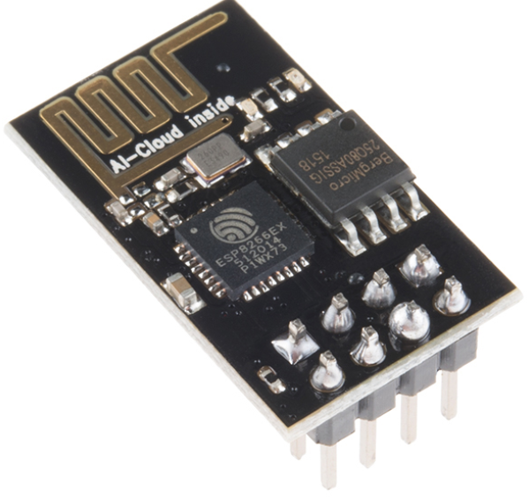
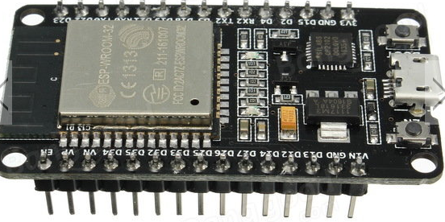
ESP8266 & ESP32: cont’d
The ESP32 chip includes two Xtensa processors along with the Wifi/Bluetooth radio and 512KB of RAM. Clock rate up to 240MHz. Available in chip, module and board form factors.

Slide 17
FPGA offerings: Papilio, XESS, Alorium
Papilio provides the DesignLab IDE tool, based on the Arduino IDE, that connects to the Xilinx ISE schematic editor tool.
Library components can be attached to a soft-core 8-bit AVR or 32-bit ZPUino. Arduino sketches provide the programming for the soft-core AVR or ZPU.
No VHDL or Verilog required. The XESS setup is similar but not as seamless.

Slide 18
Web Links
Wikipedia web pages “en.wikipedia.org/wiki/…”
Arduino, ARM_architecture, Atmel_AVR, BeagleBoard, Intel_8080, Intel_8086, LEON, MIPS_architecture, MOS_Technology_6502, NXP_ColdFire, PIC_microcontroller, Pmod_Interface, PSoC, Raspberry_Pi, RISC-V, Tensilica (Xtensa), TI_MSP430, Zilog_Z80

Slide 19
Web Links cont’d
Arduino or Raspberry board finder: www.board-db.org
Arduino software libraries: www.arduinolibraries.info, www.arduino.cc/en/Reference/Libraries
Arduino web links: www.arduino.cc/en/Main/Products, www.arduino.cc/en/Main/Software, www.wikipedia.org/wiki/List_of_Arduino_boards_and_compatible_systems
Raspberry Pi web links: www.raspberrypi.org, www.elinux.org/RPi_Hub, www.raspberrypi.org/magpi

Slide 20
Web Links cont’d
Pmod: store.digilentinc.com/pmod-modules, maximintegrated.com (search for Pmod), wiki.analog.com/resources/alliances/xilinx#pmods
Grove: wiki.seeed.cc/Grove_System, www.dexterindustries.com/GrovePi/supported-sensors
Qwiic: sparkfun.com/qwiic
Snap Circuits: http://www.snapcircuits.net/
littleBits: https://littlebits.cc/

Slide 21
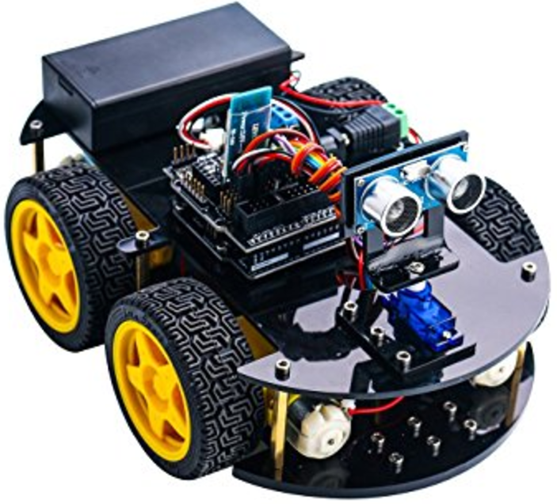
Elegoo Smart Car Robot kit

Slide 22
Neat videos
At 1:50 & 8:29 Build Your Own Arduino Uno: www.youtube.com/watch?v=sNIMCdVOHOM
At 12:55 "touch pin" music: www.youtube.com/watch?v=SBG7ccW5gpA
Andreas Spiess videos on YouTube: www.youtube.com/channel/UCu7_D0o48KbfhpEohoP7YSQ

Slide 23
Raspberry Pi boards
All have: HDMI video out, USB ports(s), SD card for “disk” storage, camera connector, WiFi, 40 pin GPIO DIL header
Pi Zero W: ARM11 processor, 512MB memory, 1.18” by 2.56”
Pi 1: ARM11, 512MB memory, 2.22” by 2.56”
Pi2: ARM quad Cortex A7, 2.22” by 3.37”
Pi3: ARM quad Cortex A53 (64-bit processor), 1GB memory, 2.22” by 3.37”

Slide 24
Some Other Time
microPython: Runs on medium size uP
Node Red: Schematic editor for operation of networked nodes
LoRa: Long range radio using sub GHz bands, up to 100km range, low bandwidth
FPGA soft-cores: AVR & ZPU cores, ZPU runs Linux, user adds peripherals schematically
IOT: WiFi becoming standard on base boards

